Slide 1
Tips and Tricks for Microsoft Fabric Data Warehouse
SQL Saturday Jacksonville
May 3rd, 2025

Slide 4

SQL Clinic
Get your SQL questions answered here by our SQL experts during our breaks!
(Across from Registration)

Slide 5

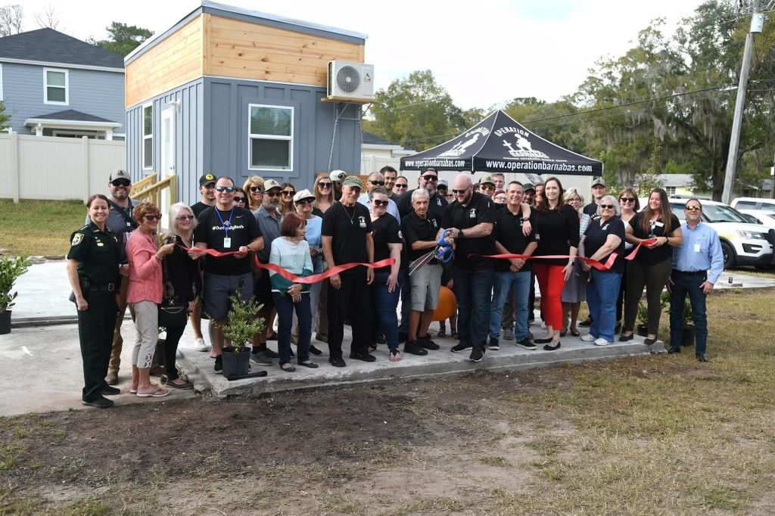

501 Legion Charitable Donation For Housing
Thank the 501 Legion for Supporting Our Event!
JSSUG Will Match Donations up to $500
Donation Bucket on Registration Table
Our vision for Ft. Barnabas is to one day be a bastion of hope and stability in guiding veterans on their path to stability. Fort Barnabas will be constructed as a mixture of portable tiny homes, or “Barnabas Bungalows,” and brick-and-mortar condo-style family homes. https://operationbarnabas.com/get-involved/

Slide 6
Session Evaluations
Your feedback is important to us!
Please fill out and hand to speaker after the session!

Slide 7
Event Evaluation
Fill out event evaluation card in your bag and visit all sponsors to be entered to win an Xbox Series X – (Must be present to win)

Slide 8
Register now!
See you in Seattle!
Get $150 off a 3-day ticket!
Use code: SQLSATJACKS150
passdatacommunitysummit.com

Slide 9

He / him pronouns
Microsoft Data Platform MVP
Independent Analytics and DBA Consultant
Albuquerque data platform group leader
Contact me:
Bluesky: @ChrisHyde325
LinkedIn: /in/chris-hyde-3803706/
Email: chrishyde325@gmail.com
Chris Hyde
Owner and Principal Consultant
Hydrate Consulting, LLC

Slide 10
Agenda
Brief overview of Microsoft Fabric Data Warehouse
Design for performance
Direct Lake mode in Power BI
Workarounds for T-SQL limitations
My ELT patterns

Slide 11
What is Microsoft Fabric?
Microsoft’s next generation all-in-one data analytics product
Full integration of data warehousing, data engineering, and data science tools into the same portal as Power BI (reporting and data visualization)
Software-as-a-Service (SaaS) rather than Platform-as-a-Service (PaaS)
One copy of data in the integrated OneLake data lake

Slide 12
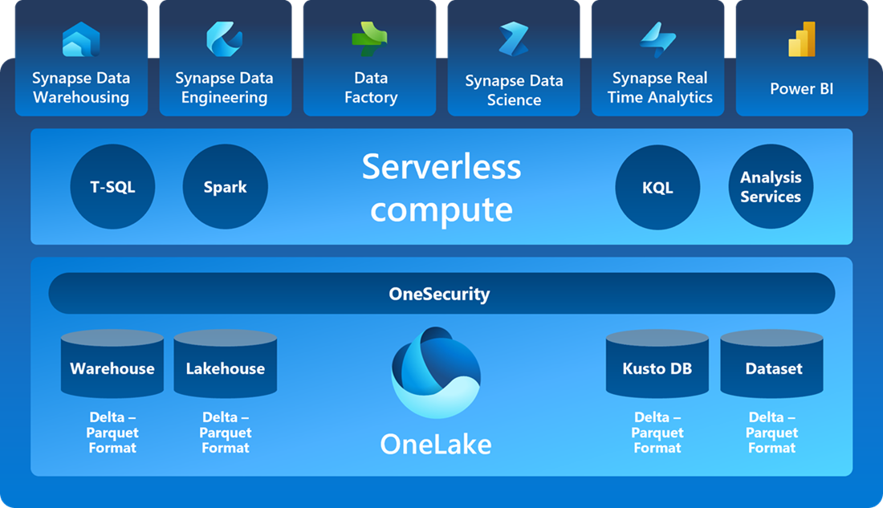
SaaS Foundation

Slide 13
What is Fabric DW?
T-SQL based data warehousing experience
Denormalized tables optimized for reporting
Stored Procedures
Parquet Files
Queryable through query tools, incl. Power BI

Slide 14
1. Consider Latency
Collocate resources where possible
Network latency between client and compute
Network latency between compute and shortcuts
Data latency of large result sets
https://learn.microsoft.com/en-us/fabric/data-warehouse/guidelines-warehouse-performance
Notes:
It's easy to forget about the effect of data latency on our Fabric warehouses. After all storage and compute have usually been tightly coupled, as in an on-premises SQL Server data warehouse. However, because Microsoft Fabric is a Software-as-a-Service solution where storage and compute are decoupled, we should stress the co-location, where possible, of both client-to-engine and engine-to-data connections.
When we execute queries, the transfer of the query result sets to the client computer can significantly impact performance, especially with large result sets. If possible, we should ensure that the client computer is in the same region as the Fabric capacity to minimize network latency. If that's not possible, be aware that the number of rows in the result set will impact the query duration. Speaking of the number of rows, we should also keep in mind the that query editor in the Fabric UI returns only the first 10,000 rows of the data set. If we need more, we should connect to the warehouse using SSMS, aka SQL Server Management Studio, or Azure Data Studio. Also, SSMS and Azure Data Studio will give us somewhat better performance anyway compared to the Fabric UI due to their TDS binary format communication with the engine.

Slide 15
2. Table Design – Star Schema
Denormalized data
Fact tables – countable data
Dimension tables – slicing-and-dicing
Also will include integration tables
https://learn.microsoft.com/en-us/fabric/data-warehouse/guidelines-warehouse-performance
Notes:
You'll want to organize the tables in your data warehouse into what is known as a star-schema design. This organizes data into primarily two types of tables, fact and dimension tables. Fact tables contain quantitative, or countable, data that are commonly generated in your transactional systems. For example, sales transaction details, or patient appointments, or as in the image shown on the next slide, NY taxi cab trips.
Dimension tables contain descriptive data about different attributes of your data. For example, the name and address of the customer placing a sales order, the demographics of a particular patient, or dates and location of taxi trips. These are the attributes that are commonly used to "slice-and-dice" or group your data on.
This design facilitates analytical processing by de-normalizing the data from your highly normalized OLTP systems, ingesting transactional data and enterprise master data into a common, cleansed, and verified data structure that minimizes JOINS at query time, reduces the number of rows read and facilitates aggregations and grouping processing.
You will also find that you have a third category of table called an integration table. These might be staging tables used to store the raw data that has been ingested via a pipeline from your OLTP systems, or perhaps temporary integration tables used to store the results of intermediate steps and calculations as you are transforming your data.
You have a number of different ways to organize your data using different schema names, table prefixes, and multiple warehouses. I prefer to avoid table prefixes and instead use different schemas to separate my fact and dimension tables, although I will often call these schemas data and lookup rather than fact and dim to be more easily understood by my analysts. And because Fabric fully supports cross-warehouse querying using a three-part naming convention, I will usually separate out my integration tables into different staging warehouses to keep them separate from the conformed and verified data.

Slide 16
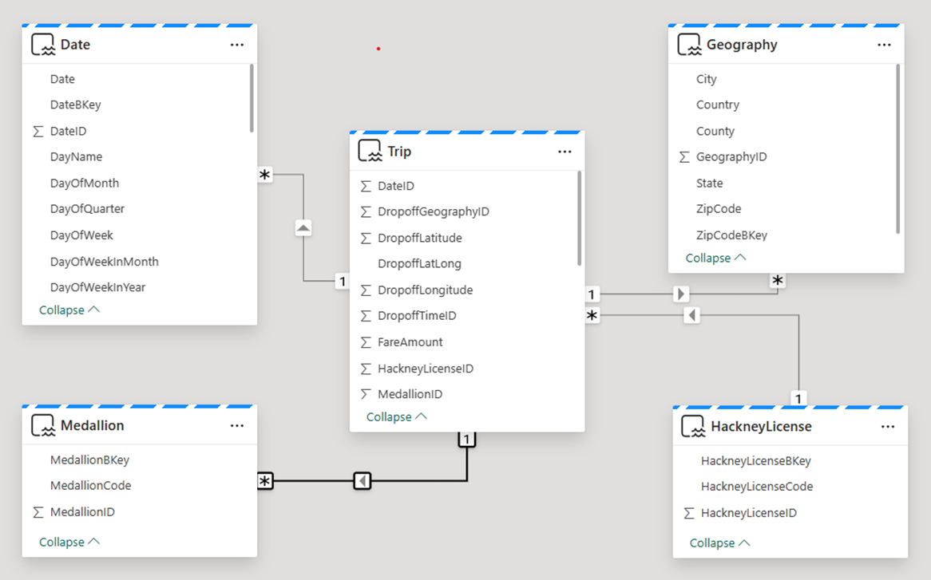
2. Table Design – Star Schema
Notes:
Dimension tables contain descriptive data about different attributes of your data. For example, the name and address of the customer placing a sales order, the demographics of a particular patient, or dates and location of taxi trips. These are the attributes that are commonly used to "slice-and-dice" or group your data on.
This design facilitates analytical processing by de-normalizing the data from your highly normalized OLTP systems, ingesting transactional data and enterprise master data into a common, cleansed, and verified data structure that minimizes JOINS at query time, reduces the number of rows read and facilitates aggregations and grouping processing.
You will also find that you have a third category of table called an integration table. These might be staging tables used to store the raw data that has been ingested via a pipeline from your OLTP systems, or perhaps temporary integration tables used to store the results of intermediate steps and calculations as you are transforming your data.
You have a number of different ways to organize your data using different schema names, table prefixes, and multiple warehouses. I prefer to avoid table prefixes and instead use different schemas to separate my fact and dimension tables, although I will often call these schemas data and lookup rather than fact and dim to be more easily understood by my analysts. And because Fabric fully supports cross-warehouse querying using a three-part naming convention, I will usually separate out my integration tables into different staging warehouses to keep them separate from the conformed and verified data.

Slide 17
3. Table Design – Data Types
Use the smallest data type possible
Use data types supported by parquet
Use NOT NULL instead of NULL where possible, especially primary/foreign key fields
Validate table schemas created by tools (e.g. Pipelines)
https://learn.microsoft.com/en-us/fabric/data-warehouse/data-types
Notes:
Analyzing your data to find what data types and ranges can be expected will pay off with performance benefits as well. Try to use the smallest data type that accomodates your values, such as an INT instead of a BIGINT for a year number column. You should specify the precision and scale of all decimals, use varchar instead of char for strings, and declare columns as NOT NULL wherever possible. Also, if your table has been created by a tool rather than a CREATE TABLE script, for example using Pipelines, you'll want to double-check that appropriate data types were created. Let's run a quick demo of this...

Slide 18
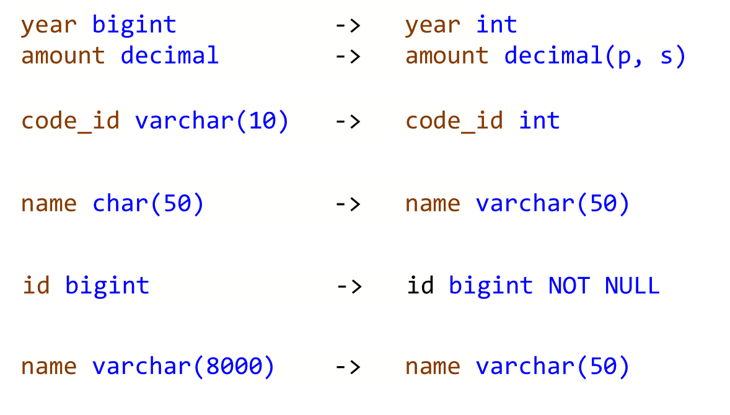
3. Table Design – Data Types

Slide 19
Data Pipeline Demo

Slide 20
4. Direct Lake Considerations
Power BI Direct Lake mode (diagram next slide)
Several current limitations
Limitations detailed at: https://learn.microsoft.com/en-us/power-bi/enterprise/directlake-overview#known-issues-and-limitations
Marco Russo on Direct Lake vs. Import Mode: https://www.sqlbi.com/blog/marco/2024/04/06/direct-lake-vs-import-mode-in-power-bi/

Slide 21
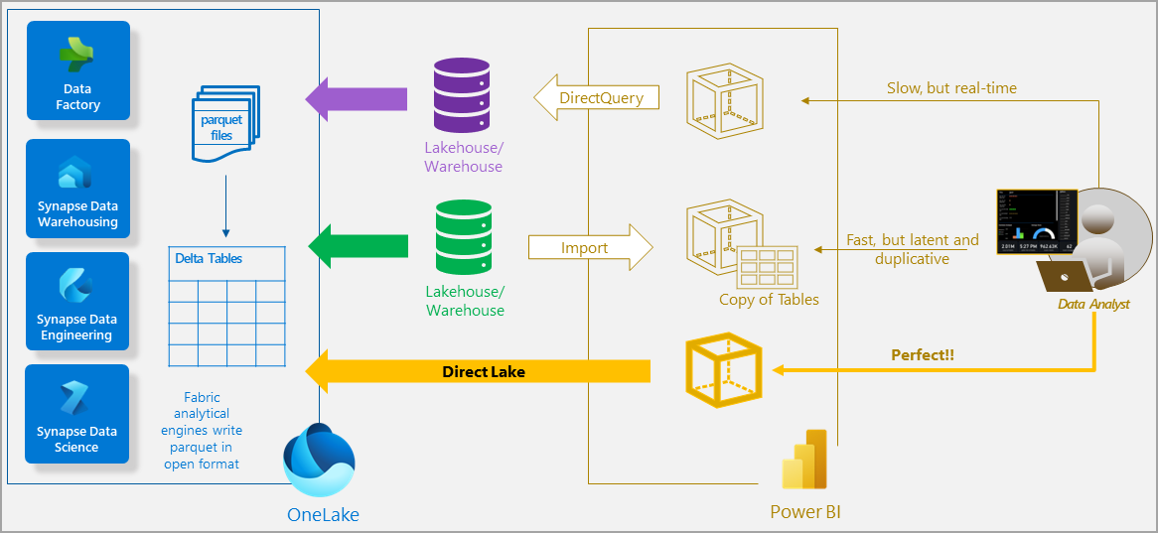

Slide 22
Unsupported in Direct Lake
Model contains tables from more than one warehouse
Model contains calculated columns and tables
Model contains relationships based on datetime columns
Key column data types do not coincide or are not unique

Slide 23
Fallback to DirectQuery
A query reads data from a view contained in the model
SSO authentication is used when SQL endpoint security has been defined

Slide 24
Schema Patterns for Direct Lake
On premises / Not using Direct Lake:
fact and dim contain tables
data and lookup contain views
etl contains orchestration items
In Fabric DW for Direct Lake:
data and lookup contain tables
etl contains orchestration items

Slide 25
5. Modeling Dimension Tables
Slowly-changing dimensions
Dimension metadata fields
Sentinel values

Slide 26
Slowly-Changing Dimensions
Type 0 – no updates
calendar / date tables
Type 1 – update in place; no historical record reqd.
college example – student name
Type 2 – data versioning
college example – gender and ethnicity
Can mix within same dimension table

Slide 27
Dimension Metadata Fields
Source System Name
Source System Key
SCD Type 1 Hash Value
SCD Type 2 Hash Value
Active Record Flag
Start Effective Date (in warehouse)
End Effective Date (in warehouse)
Record Last Updated Date/Time

Slide 28
Sentinel Values
Default dimension members
Unknown
e.g. Student record mismatch
Missing
e.g. Student grades for in-process classes

Slide 29
6. T-SQL Limitations
True lift-and-shift not quite there yet
Several T-SQL enhancements on the DW product roadmap

Slide 30
T-SQL Limitation #1
No temp tables
Making complex business logic simpler
Separating complex business logic from “plumbing”
Workaround - Physically materialize a table in temp schema
But watch out for – Concurrent updates

Slide 31
T-SQL Limitation #1 Fixed!
Two types of session-scoped temporary tables are available as of April 22nd
Globally-scoped temporary tables are not available
Non-distributed temp tables work like classic T-SQL temp tables; Distributed ones declared as round-robin
https://blog.fabric.microsoft.com/en-US/blog/announcing-the-general-availability-of-session-scoped-distributed-temp-tables-in-fabric-data-warehouse/

Slide 32
T-SQL Limitation #2
No INSERT INTO… EXEC from a stored procedure
Re-locate transformation logic
Separating complex business logic from “plumbing”
Workaround – Use physical “temp” tables
But watch out for – Concurrent updates

Slide 33
T-SQL Limitation #3
No MERGE statement
Is this really a limitation? ☺
Workaround - Separate INSERT and UPDATE statements
But watch out for – Handling transactions

Slide 34
T-SQL Limitation #4
No IDENTITY() columns
Workaround - Use ROW_NUMBER() function plus a seed
But watch out for – Concurrent inserts

Slide 35
7. Leverage the Lakehouse
File Storage
Medallion Architecture options
Bronze and Silver layers in the Lakehouse
Gold layer in the Warehouse
Lakehouse shortcuts to Data Warehouses in different workspaces

Slide 36
Resources
https://github.com/DrJekyll325/Presentations
aka.ms/fabric-learn
aka.ms/FabricRoadmap

